Slide 1


GO! with Microsoft 365®
Excel 2025 Edition
Chapter 3
Analyzing Data with Pie Charts, Line Charts, and What-If Analysis Tools
Copyright © 2026, 2023, 2020 Pearson Education, Inc. All Rights Reserved
Notes:
If this PowerPoint presentation contains mathematical equations, you may need to check that your computer has the following installed:
1) Math Type Plugin
2) Math Player (free versions available)
3) NVDA Reader (free versions available)
GO! With Microsoft 365
Excel 2025 Edition
Chapter 3: Analyzing Data with Pie Charts, Line Charts, and What-If Analysis Tools

Slide 2
Learning Objectives (1 of 2)
3.1 Chart Data with a Pie Chart
3.2 Format a Pie Chart
3.3 Edit a Workbook and Update a Chart
3.4 Use Goal Seek to Perform What-If Analysis
Notes:
The objectives of this chapter are:
Chart Data with a Pie Chart
Format a Pie Chart
Edit a Workbook and Update a Chart
Use Goal Seek to Perform What-If Analysis

Slide 3
Learning Objectives (2 of 2)
3.5 Design a Worksheet for What-If Analysis
3.6 Answer What-If Questions by Changing Values in a Worksheet
3.7 Chart Data with a Line Chart
3.8 Create a Map Chart and a Funnel Chart
Notes:
The objectives of this chapter are:
Design a Worksheet for What-If Analysis
Answer What-If Questions by Changing Values in a Worksheet
Chart Data with a Line Chart
Create a Map Chart and a Funnel Chart

Slide 4
Chart Data with a Pie Chart (1 of 4)
Pie chart
Shows the relationship of each part to a whole
Fund—sum of money set aside for a specific purpose
General fund—money set aside for the normal operating activities of the municipality
Enterprise fund—reports income and expenditures related to municipal services
Data point
Value that originates in a worksheet cell
Notes:
A pie chart shows the relationship of each part to a whole, where the size of each pie slice is equal to its value compared to the total value of all the slices.
A fund is a sum of money set aside for a specific purpose. In a municipal government, the general fund is money set aside for the normal operating activities of the city, such as police, fire, and administering the everyday functions of the city. Municipal governments also commonly establish an enterprise fund to report income and expenditures related to municipal services for which a fee is charged in exchange for goods or services.
A data point is a value that originates in a worksheet cell.

Slide 5
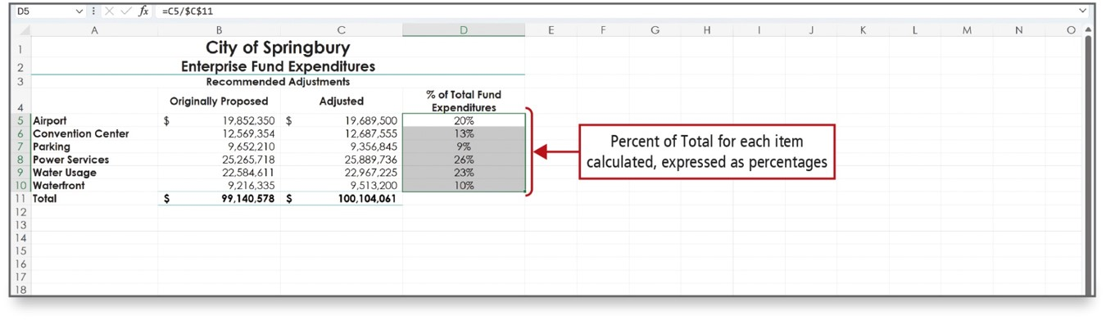
Chart Data with a Pie Chart (2 of 4)
Notes:
To create a pie chart, you must select two ranges. One range contains the labels for each slice of the pie chart, and the other range contains the values that add up to a total.
The two ranges must have the same number of cells, and the range with the values should not include the cell with the total.
In this pie chart, the contents of Column A will be used for the labels and Column D contains the values.
Long Description:
The sheet has a table titled City of Springbury: Enterprise Fund Expenditures. The column headers are Originally Proposed, Adjusted, and percentage of Total Fund Expenditures. Under the blank column, the row headers are Airport, Conventional Center, Parking, and so on. A callout pointing to the entries under the last column reads, Percent of Total for each item calculated, expressed as percentages.

Slide 6
Chart Data with a Pie Chart (3 of 4)
Data marker
Represents a data point on a chart
In a pie chart, each pie slice is a data marker
Data series
Related data points represented by data markers
Determine the size of each pie slice
Legend
Identifies patterns or colors assigned to categories
Identifies the pie slices
Notes:
A data point is a value that originates in a worksheet cell and that is represented in a chart by a data marker. A data marker is a column, bar, area, dot, pie slice, or other symbol in a chart that represents a single data point. In a pie chart, each pie slice is a data marker. Together, the data points form the data series—related data points represented by data markers— and determine the size of each pie slice.
A legend is a chart element that identifies the patterns or colors assigned to the categories in the chart. In a pie chart, the legend identifies the pie slices.

Slide 7
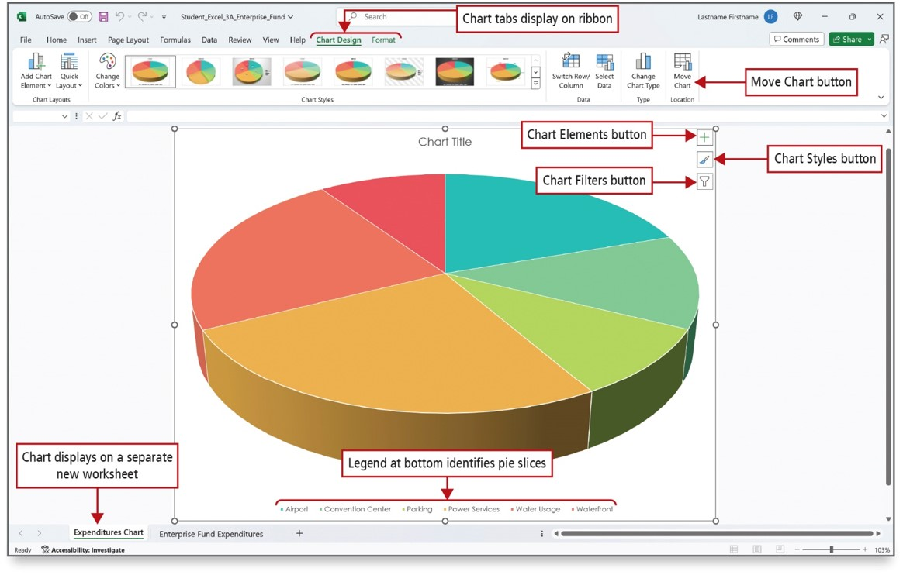
Chart Data with a Pie Chart (4 of 4)
Notes:
This pie chart was created from ranges A5:A10 and D5:D10 on the worksheet. The chart has been placed on a chart sheet—a workbook sheet that contains only a chart.
Long Description:
The Chart Design tab is selected. A pie chart style is selected from the Chart Styles group. At the top right corner are three icons: plus, paint brush, and filter. The callouts are as follows: the tabs Chart Design and Format: Chart tabs display on ribbon; the Move Chart button: Move Chart button; the plus icon: Chart elements button; the paint brush icon: Chart styles button; filter icon: Chart filters button; the legend: Legend at the bottom identifies pie slices.

Slide 8
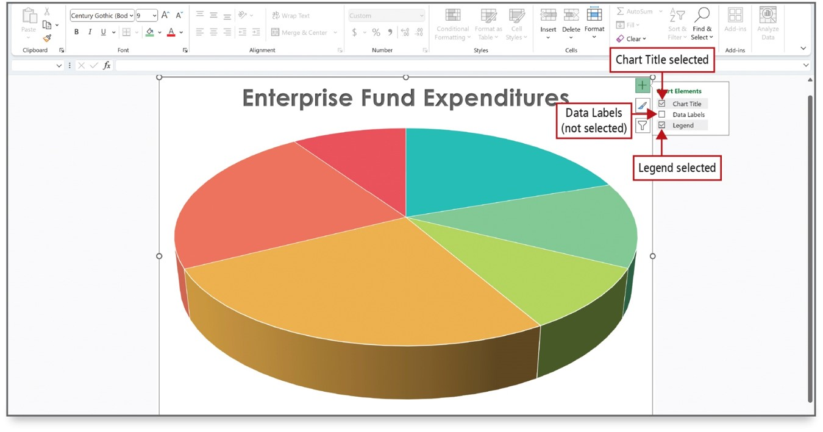
Format a Pie Chart (1 of 4)
Notes:
The Chart Elements button allows you to add, remove, or change chart elements such as the chart title, the legend, and the data labels. In the figure, a title and legend are selected to be added to the chart.
Long Description: In the Excel sheet, a pie chart is with three icons on the top right corner: plus, paint brush, and filter. The Plus button shows a menu for Chart Elements with Chart Title, Data Labels, and Legend. The callouts are as follows: Chart Title: Chart Title selected; Data Labels: Data Labels (not selected); Legend: Legend selected.

Slide 9
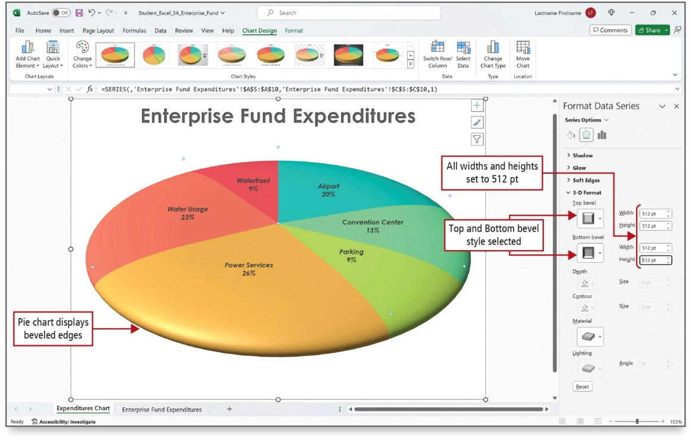
Format a Pie Chart (2 of 4)
Notes:
3-D or three-dimensional, refers to an image that appears to have all three spatial dimensions—length, width, and depth.
Bevel is a shape effect that uses shading and shadows to make the edges of a shape appear to be curved or angled. The chart on this figure has both 3-D and bevel effects added to it. Data labels have also been added to the slices.
Long Description:
The Format Data Labels pane has sections for effects and under the section 3-D format are dropdown buttons for Top bevel and Bottom bevel, Depth, Counter, Material, and Lightning. For bevel buttons, there are spin boxes for Width and Height. For Depth and Contour, a spin box for Size. For Lightning, there is a spin box for Angle. A callout pointing to the buttons Top bevel and Bottom bevel reads, Top and Bottom bevel style selected. A callout pointing to the Width and Height boxes reads, All widths and heights are set to 512 p t. A callout pointing to the beveled edges of the pie chart reads, Pie chart displays beveled edges.

Slide 10
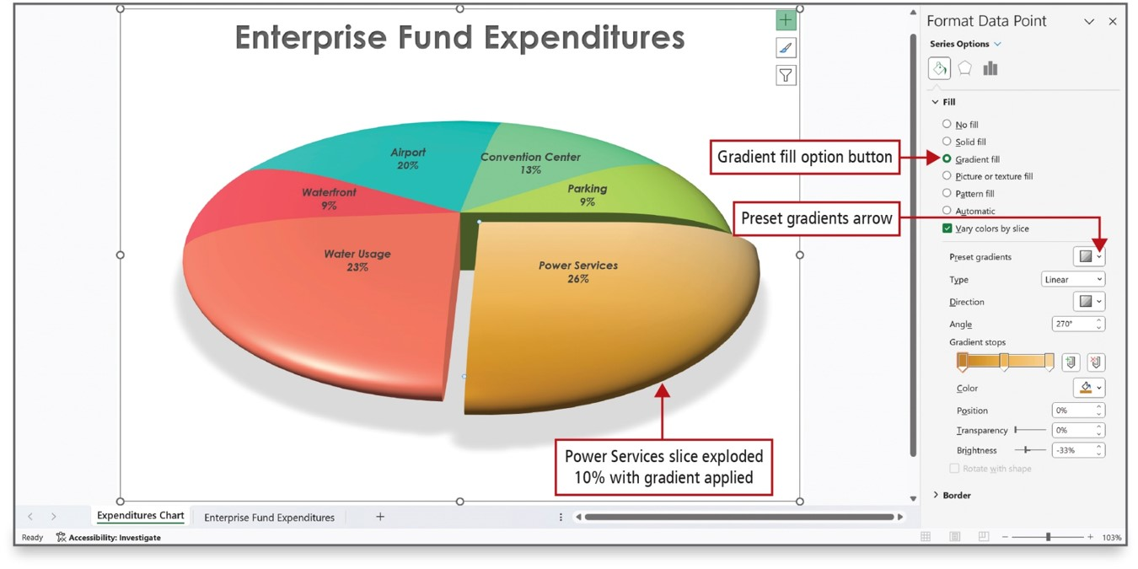
Format a Pie Chart (3 of 4)
Notes:
The pie chart on this slide has one piece of the pie exploded—pulled out from the rest—for emphasis. It also has a shadow emphasis added and is rotated. The order in which the data series in pie charts are plotted is determined by the order of the data on the worksheet. To gain a different view of the data, you can rotate the chart with the 360 degrees of the circle, which is what was done here.
Long Description:
The Format Data Labels pane has the Fill section with radio buttons such as No fill, Solid fill, Gradient fill, and so on and the section Present gradients settings with dropdowns for Present gradients, Type, Direction, and Color and spin boxes for Angle, Position, Transparency, and Brightness. The field Gradient stops has a scale bar with two buttons. The Gradient fill option under the Fill section is selected. The arrow of the dropdown Present gradients is labeled Present gradients arrow. The pie chart has slices for Airport, Convention Center, Parking, Power Services, Water Usage, and Waterfront. The slice Power Services is separated from others with a gap, and the corresponding callout reads, Power Services slice exploded 10 percent from gradient applied.

Slide 11
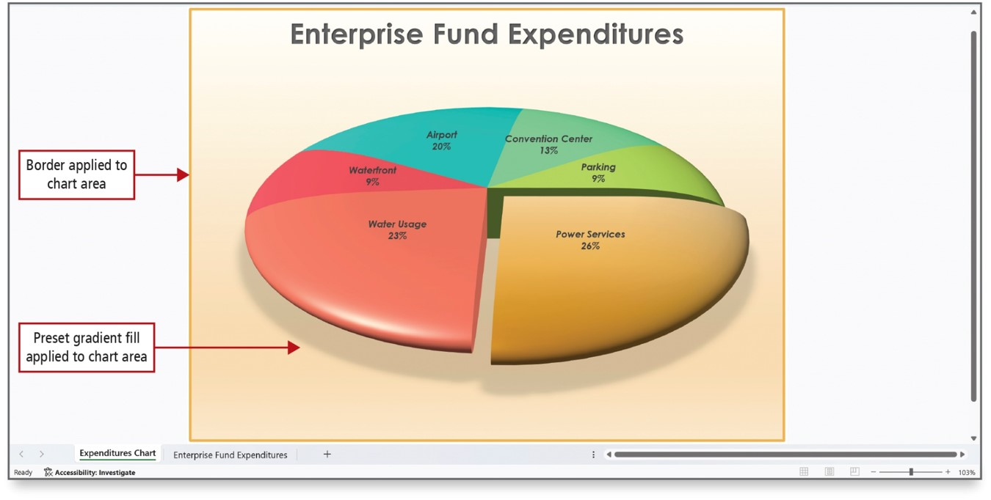
Format a Pie Chart (4 of 4)
Notes:
The entire chart and all its elements comprise the chart area, and its components can be formatted. Here, the completed chart has a background and border applied to the chart area.

Slide 12
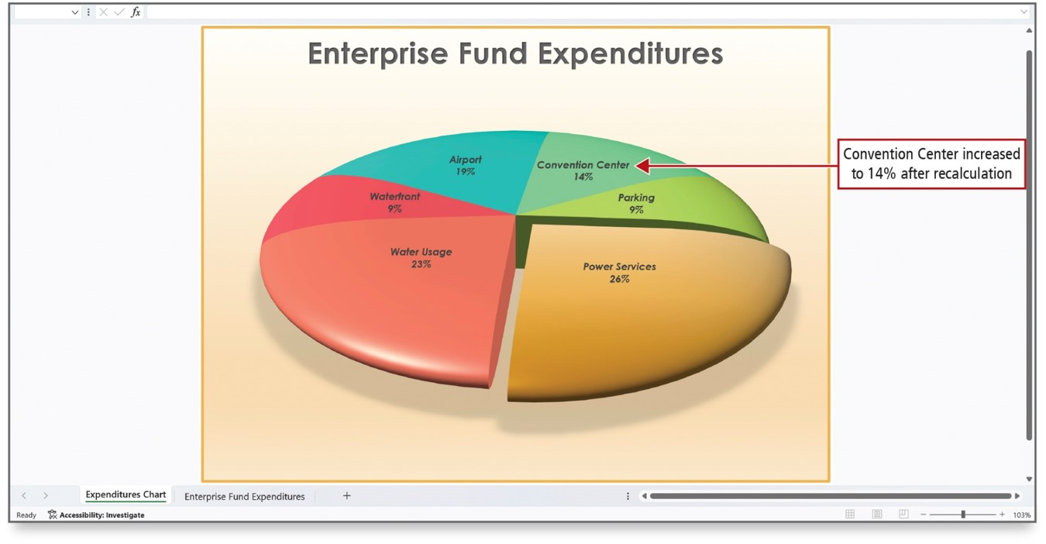
Edit a Workbook and Update a Chart
Notes:
If you edit the data in your worksheet, the chart data markers—in this instance, the pie slices—will adjust automatically to accurately represent the new values. A quick way to edit cell data is to double-click the cell to position the insertion point in the cell and edit the data.
Long Description:
The pie chart has the following slices: Convention center, 14 percent. Parking, 9 percent. Power Services, 26 percent. Water Usage, 23 percent. Waterfront, 9 percent. Airport, 19 percent. A callout pointing to Convention center reads, Convention center increased to 14 percent after recalculation.

Slide 13
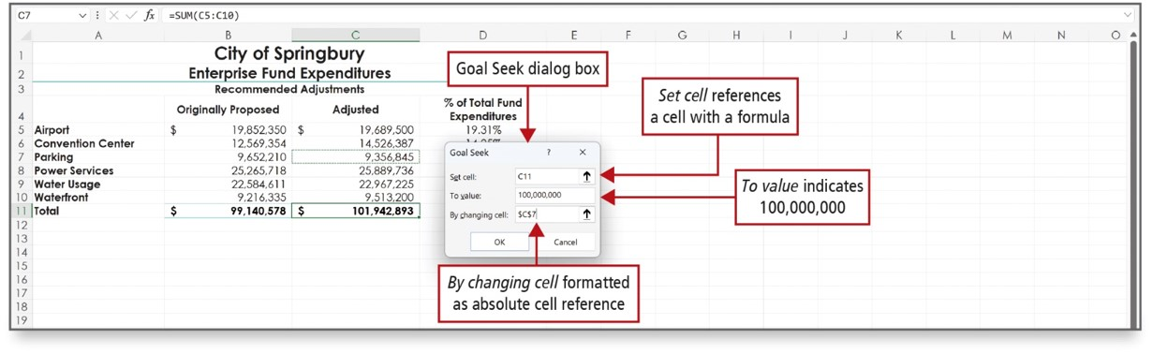
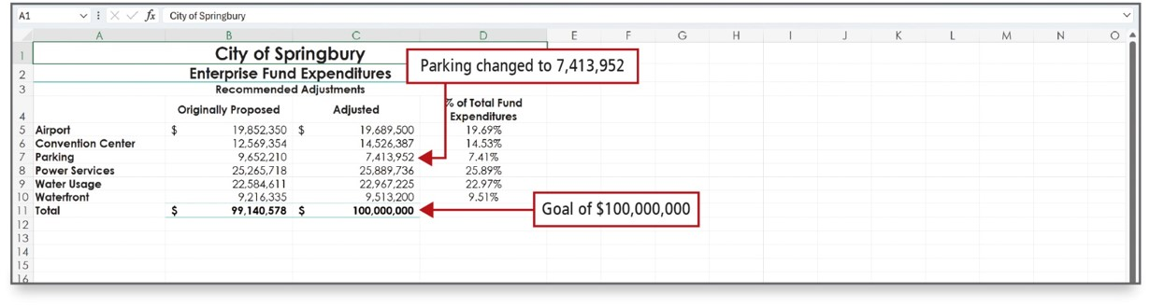
Use Goal Seek to Perform What-If Analysis
Notes:
The process of changing the values in cells to see how those changes affect the outcome of formulas in your worksheet is referred to as what-if analysis.
Goal Seek is one of the what-if analysis tools in Excel. Goal Seek finds the input needed in one cell to arrive at the desired result in another cell. In this example, C11 is the cell in which you want to set a specific value.
Long Description 1:
There are three fields in the dialog box: Set cell, To value, and By changing cell. The Set cell box is set to C 11, and the corresponding callout reads, Set cell references a cell with a formula. The To value box is set to 100,000,000, and the corresponding callout reads, To value indicates 100,000,000. The By changing cell box is set to dollar C dollar 7, and the corresponding callout reads, By changing cell formatted as an absolute cell reference.
Long Description 2:
A table is titled City of Springbury: Enterprise Fund Expenditures. The column headers are blank, Originally Proposed, Adjusted, and percent of Total Fund Expenditures. The categories are Airport, Convention Center, Parking, Power Services, Water Usage, Waterfront, and Total. For the category Parking, the amount for Originally Proposed is 9,652,210, the amount for Adjusted is 7,413,952, and percent of Total Fund Expenditures is 7.41 percent. A callout pointing to amount for Adjusted for Parking reads, Parking changed to 7,413,952. The total corresponding to Originally Proposed is 99,140,578 dollars. The total corresponding to Adjusted is 100,000,000 dollars. The corresponding callout reads, Goal of 100,000,000 dollars.

Slide 14
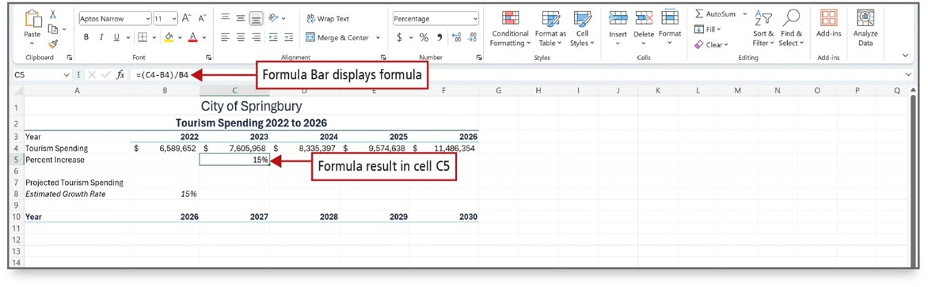
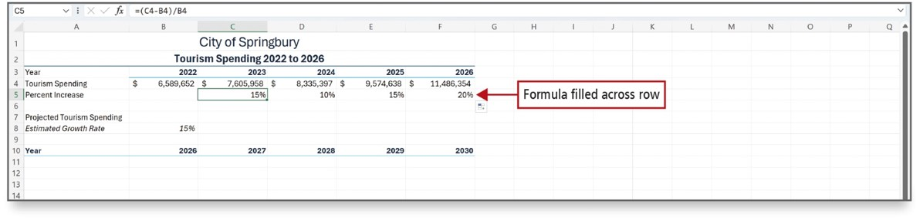
Design a Worksheet for What-If Analysis (1 of 2)
Notes:
In the top figure, a formula is constructed to calculate the percentage rate of increase—the percent by which one number increases over another number—for each year since 2022. From this information, future tourism spending growth can be estimated.
It is important to recall the order of operations: parentheses, exponentiation, multiplication, division, addition, and subtraction.
The bottom figure shows the formula filled across the row for the remaining years.
Long Description:
The sheet has a table titled City of Springbury and subtitled Tourism Spending 2022 to 2026 with column headers for Year, 2022, 2023, 2024, 2025, and 2026. There is a separate row for Year with the column entries as 2026, 2027, 2029, and 2030. The formula in the formula bar reads, equals open parenthesis C 4 minus B 4 close parenthesis over B 4. The callouts are as follows: a percentage value in the Percentage Increase row: Formula result in cell C 5 and the corresponding formula in the formula bar: Formula Bar displays formula.

Slide 15
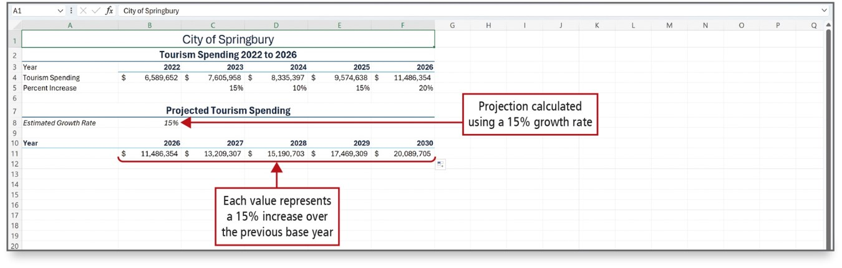
Design a Worksheet for What-If Analysis (2 of 2)
Notes:
The projected spending for 2027 is calculated using an absolute reference to cell B8. Changing cell B8 allows you to see the result of different spending growth rates for subsequent years.
Cell B8 has a value of 15% and the calculations show the result of 15% growth for each of the years after 2026.
Long Description:
The sheet has tables for tourism spending 2022 to 2026 and projected tourism spending. A callout pointing to the estimated growth rate of 15 percent displayed in cell B 8 reads, Projection calculated using a 15 percent growth rate. Cells B 11 to F 11 have values in dollars under the columns 2026, 2027, 2028, 2029, and 2030 pertaining to the Year row. Another callout for the values in cells B 11 to F 11 reads, Each value represents a 15 percent increase over the previous base year.

Slide 16
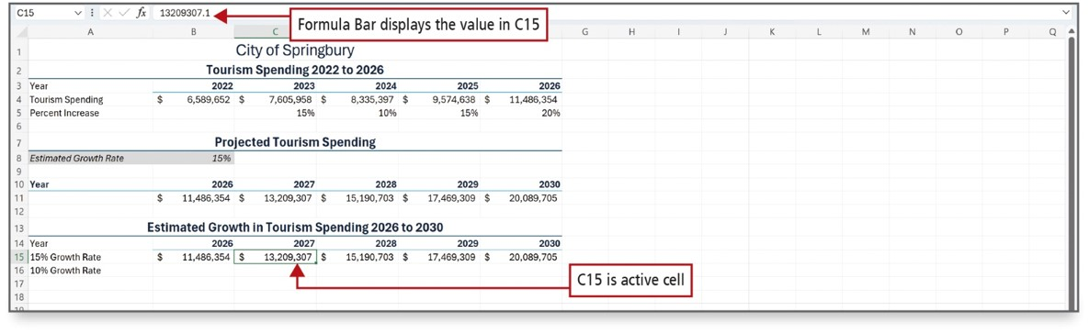
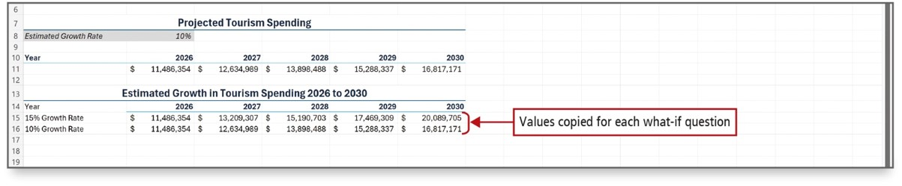
Answer What-If Questions by Changing Values in a Worksheet
Notes:
If a formula depends on the value in a cell, you can see what effect it will have if you change the value in that cell. Then, you can copy the value computed by the formula and paste it into another part of the worksheet where you can compare it to other values. You may want to keep the results of a calculation so it can be compared, as shown here.
In the bottom figure. the calculated estimates based on different growth rates are pasted along with the formatting.
With this information, what-if questions about the projected increase in tourism spending based on the rates of increase over the past five years can be answered. Don’t underestimate the power of using what-if analysis.
Long Description 1:
The sheet has tables for tourism spending, projected tourism spending, and estimated growth in tourism spending. The second row has a row for Estimated Growth Rate. There is a row for Year with columns from 2026 to 2030 for both second and third tables. Cell C 15 is the amount in dollars under the column 2027. The callouts are as follows: cell C 15: C 15 is active cell and the formula bar: Formula Bar displays the value in cell C 15.
Long Description 2:
The sheet has the tables for projected tourism and spending each with a row for Year with columns from 2026 to 2030. A callout pointing to the values 20,089,705 dollars and 16,817,171 dollars in cells F 15 and F 16 under the column 2030 in the second table reads, Values copied for each what-if question.

Slide 17
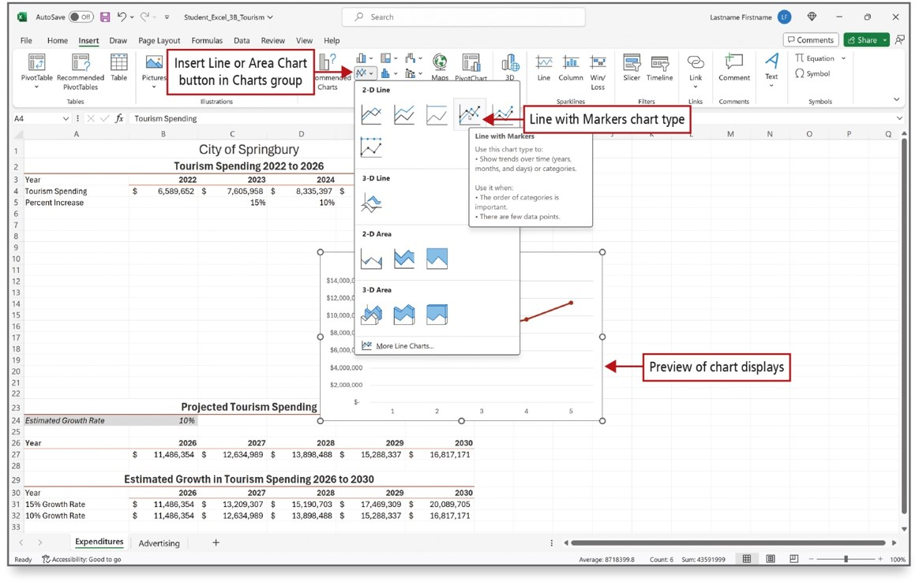
Chart Data with a Line Chart (1 of 4)
Notes:
A line chart displays trends over time. Time is displayed along the bottom axis and the data point values connect with a line. The gallery of line charts, as shown here, display a ScreenTip for each line chart type that helps describe the type of chart.
Long description:
The Insert tab is selected. The Charts section of the Excel ribbon contains an Insert Line or Area Chart button (the first button in the second row). A gallery opens by clicking this button. The gallery displays various options of 2-D, 3-D line charts, and 2-D, 3-D area charts. The fourth option in the 2-D line chart is selected and labeled as Line with Markers chart type. On selecting this option a ScreenTip titled Line with Markers pops up. A callout pointing to the preview below the gallery reads, preview of hart displays.

Slide 18
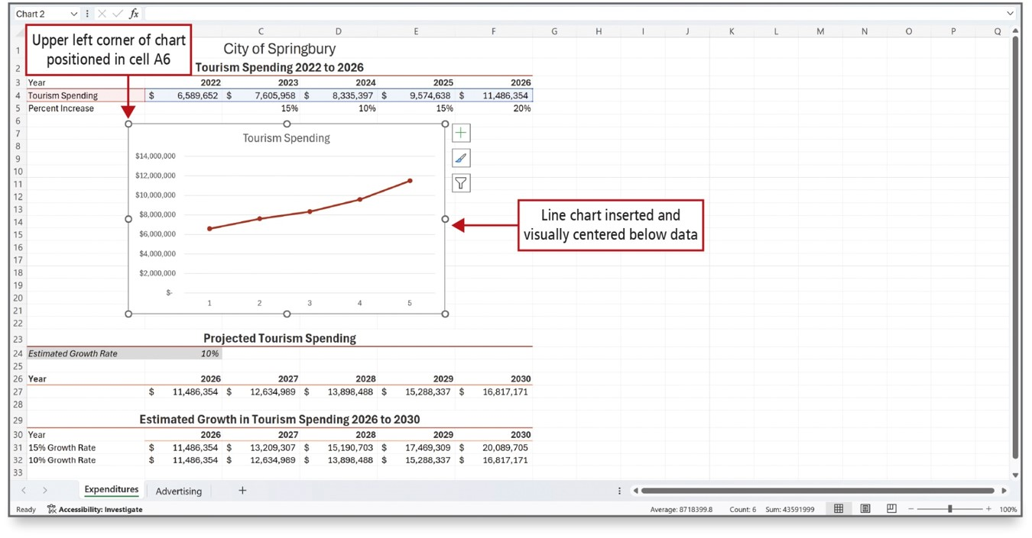
Chart Data with a Line Chart (2 of 4)
Notes:
Three chart elements are included in a line chart by default—the axes, the chart title, and the gridlines. Additional elements can be added through the Chart Elements button that displays on the right side of a selected chart.
Long Description:
A line chart is under the table Tourism Spending 2022 to 2026. The line chart is titled Tourism Spending and has 1 to 5 on the horizontal axis and tourism spending expenditures on the vertical axis. A callout pointing to the top left border sphere of the line chart reads, Upper left corner of chart positioned in cell A6. A callout pointing to the right middle border sphere of the chart reads, Line chart inserted and visually centered below data. Below the line chart are sections for Projected Tourism Spending and Estimated Growth in Tourism Spending 2026 to 2030.

Slide 19
Chart Data with a Line Chart (3 of 4)
Axis
Line that serves as a frame of reference for measurement
Borders the chart plot area
Plot area
Area bounded by the axes, including all the data series
Category axis or x-axis
Area along the bottom of a chart that identifies the categories of data
Value axis or y-axis
Area along the left side of a chart that shows the range of numbers for the data points
Notes:
The axis is a line that serves as a frame of reference for measurement, and it borders the chart plot area.
The plot area is the area bounded by the axes, including all the data series.
The category axis or x-axis is the area along the bottom of a chart that identifies the categories of data.
The value axis or y-axis is the area along the left side of a chart that shows the range of numbers for the data points.

Slide 20
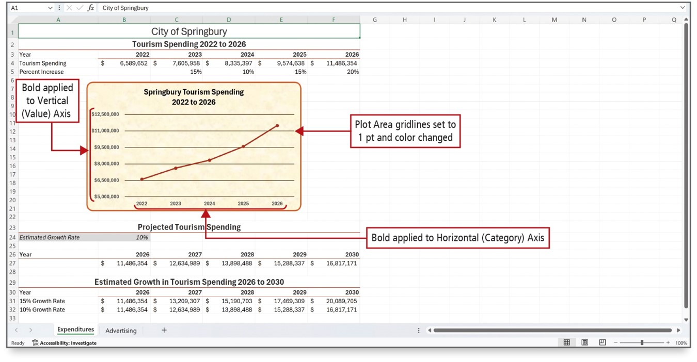
Chart Data with a Line Chart (4 of 4)
Notes:
The figure shows a chart with formatting elements changed to better display the data and make the chart more readable.
Bounds—minimum and maximum numbers on a y-axis and unit spacing between those—can be set.
By default, Excel started the values at zero and increased in increments of $1,500,000. Bounds have been changed in the chart to make it more visually appealing and more representational of the data it is trying to portray.
Gridlines and axis labels have been formatted with bold and with changes to font color and size.
This chart has a graphic texture added as the chart area background.
Long description:
A line chart titled Springbury Tourism Spending plots expenditures for years 2022 to 2026. The horizontal lines on the chart are labeled as Plot Area gridlines set to 1 p t. The values on the y-axis are labeled as Bold applied to vertical (value) axis and values on the x-axis are labeled as Bold applied to horizontal (category) axis.

Slide 21
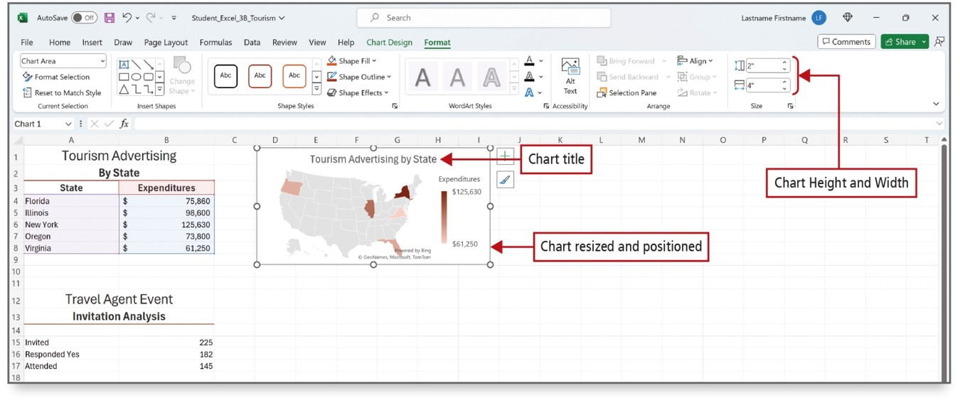
Create a Map Chart and a Funnel Chart (1 of 2)
Notes:
A map chart compares values and shows categories across geographical regions; for example, across countries, states, counties, and regions. The charted regions display in map form, and each region displays shading to indicate the values in the data series.
A map of the United States displays to the right of the data. The five states display varying shades of red. Virginia—the state in which the fewest advertising dollars are spent—is the lightest shade of red. New York—the state in which the most advertising dollars are spent—is the darkest shade of red. The legend displays the Expenditures scale from highest to lowest.
Long Description:
The table for tourism advertising has expenditures for states. The other table has expenditures for various events. The world map chart is titled Tourism Advertising by State. The lower portion of the scale of the expenditure is labeled as Chart resized and positioned. In the Size section of the Excel ribbon under the Format tab, Chart Height and Width are set to 2 inches and 4 inches, respectively. Callouts point to the Chart Height and Width spin boxes.

Slide 22
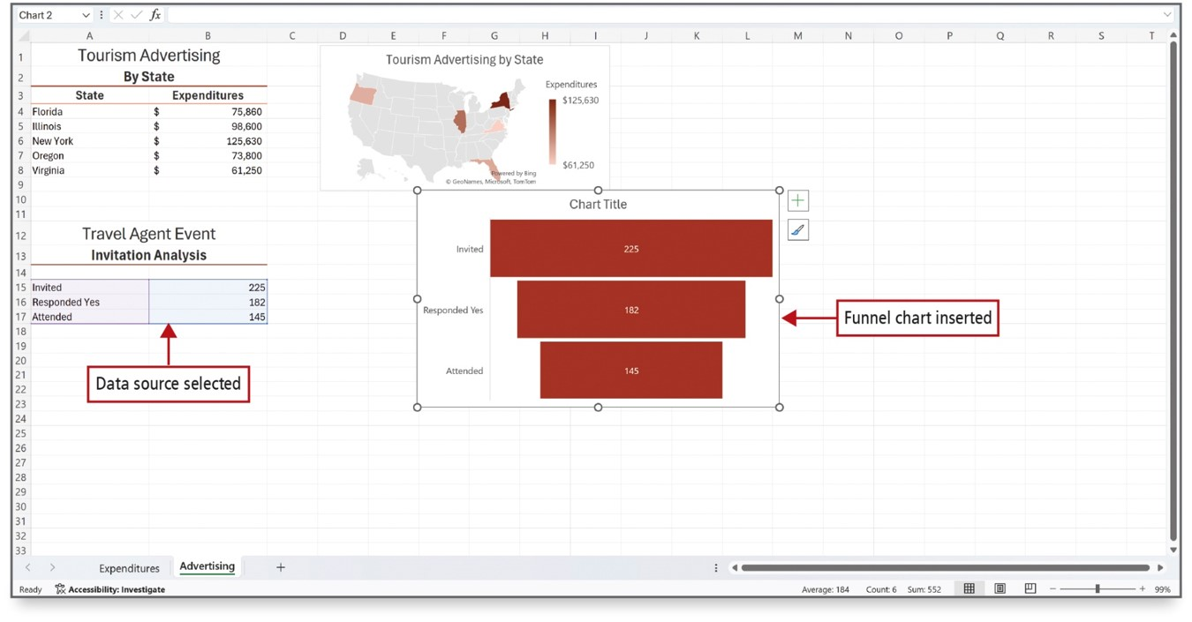
Create a Map Chart and a Funnel Chart (2 of 2)
Notes:
Funnel charts show values across the stages in a process. Typically, the values decrease gradually, allowing the bars to resemble a funnel. The funnel chart displays to the right of the data and slightly overlaps the map chart. Each rectangle in the funnel chart indicates a corresponding value from the data series. The invited guests represent the largest number, and the attending guests represent the smallest number.
Long Description:
The table for tourism advertising has expenditures for states. The other table has expenditures for various events. The world map corresponds to the first table and the funnel map to the other table. The chart contains three horizontal bars of decreasing lengths one below another. The second table data are labeled Data source selected. The funnel chart is labeled Funnel chart inserted.

Slide 23

Questions

Slide 24

Copyright
This work is protected by United States copyright laws and is provided solely for the use of instructors in teaching their courses and assessing student learning. Dissemination or sale of any part of this work (including on the World Wide Web) will destroy the integrity of the work and is not permitted. The work and materials from it should never be made available to students except by instructors using the accompanying text in their classes. All recipients of this work are expected to abide by these restrictions and to honor the intended pedagogical purposes and the needs of other instructors who rely on these materials.

